Slide 1
Lyman-α Emitters in Ionized Bubbles: Constraining the Environment and Ionized Fraction
Suyash Sakhare

Slide 2
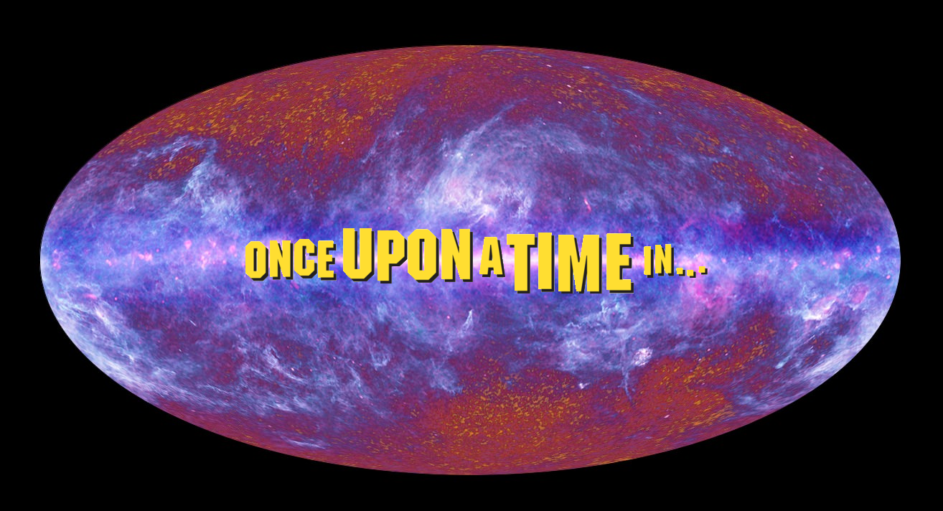

Slide 4
Reionization
Neutral hydrogen re-ionized by the energy available probably from dwarf galaxy, quasars, Population III stars (early stars)
Redshift: 20 > z > 6
Transparent and Inhomogeneous.
Detection methods exists but tell us nothing about underlying densities and ionization environment of protoclusters (associations).

Slide 5
Lyman-α Emitters (LAE)
Extremely distant young galaxies present during reionization era that emit Lyman-alpha radiation.
Photons from LAE are subject to substantial absorption by the intergalactic medium (IGM)
As redshift increases, detectable LAEs decrease.
The host galaxy must be embedded in a large ionized region
Ideal candidates usually lie in region of redshift z > 6.5

Slide 6
Our Questions for Candidate Ionized Bubbles
Candidates:
Hu et al. 2021 (14 LAEs, V ∼ 200 ${cMpc}^{3}$, z = 6.93 )
Endsley et al. 2021 (6 LAEs, V ∼ 140 ${cMpc}^{3}$, z ≈ 6.7 − 6.9)
Tilvi et al. 2020
Jung et al. 2020;
Are the LAEs in a large ionized bubbles?
Are LAEs association a protocluster that will collapse at z=0?
What fraction of the universe was ionized at a certain redshift?

Slide 7
Local Densities Assuming a High LAE Visibility
Ignoring the effects of inhomogeneous ionized bubbles.
Linear Density $δ=\frac{(ρ−\overline{ρ})}{\overline{ρ}}$
Probabilities:
Prior – Expected value with least amount of information
Posterior – Considering all the factors.
Likelihood – Considering the observed and expected densities.
Bias – Cosmic variance, Poisons Noise

Slide 8
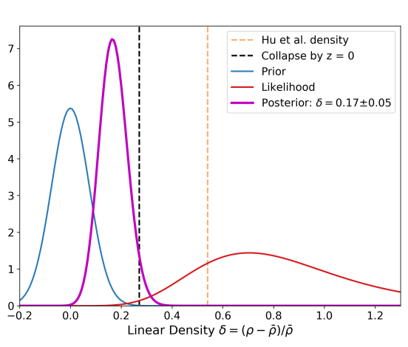
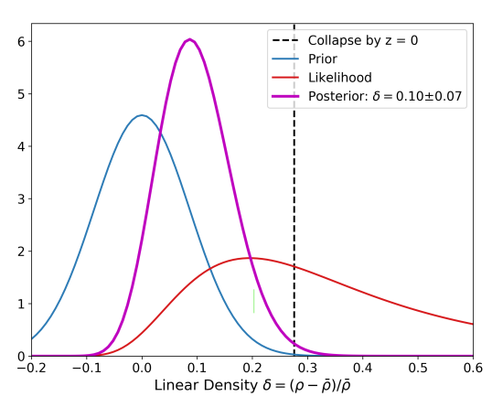
Local Densities Assuming a High LAE Visibility

Slide 9
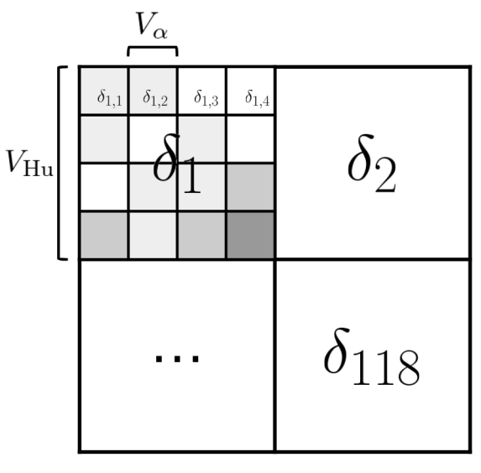
Monte Carlo Simulation
Uses Simple Model of Reionization:
All the ionizing photons come from source inside the bubble.
Neighboring regions do not cause ionization.
Ionizing efficiency independent of mass.
Using a set of Ionizing efficiency and fraction of ionization, built a simulated ionized region.
The simulated volume was divided into sub-regions based on density.

Slide 10
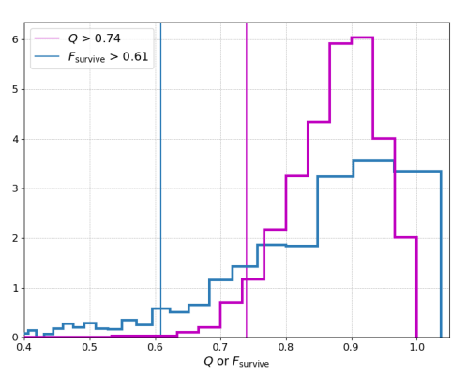
Using Simulation to Study Hu et al. 2021
Q – Ionization state of volumes in the simulation.
F_survive – Fraction of LAEs that are visible according to the simulation.
The ionized bubble is large and the fraction of visible LAEs is high.

Slide 11
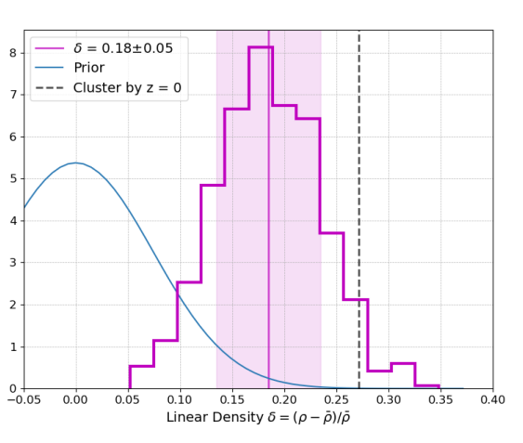
Is Hu et al. 2021 a Protocluster?
According to the simulation,
Hu et al. 2021 would not have collapsed by z=0?

Slide 12
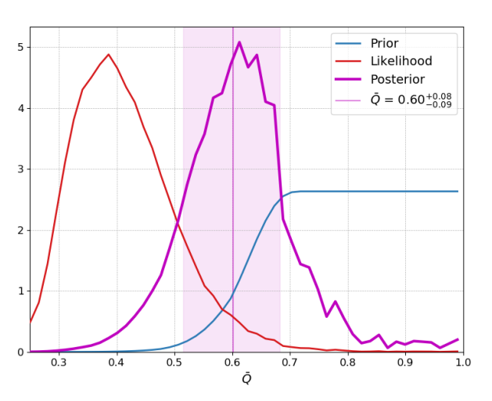
What can we learn about Reionization?
Q – Avg Ionization of Universe %
Likelihood – Fraction of Simulated Regions that had 14 LAEs.
Posterior – Factoring in effects of inhomogeneous ionization and other biases.
Global Ionization Fraction, Inference

Slide 13
Comparison with Other Studies
Results consistent with other studies.
Show that the ionization was incomplete around
z = 7.

Slide 14
A framework to identify underlying densities of ionized region based on visible LAEs was built.
Sufficiently large LAE cluster can not only identify ionized volumes with high reliability but also constrain reionization on a global scale.
LAE clusters are a promising avenue for calculating the ionized fraction of the Universe throughout reionization.

